Slide 1
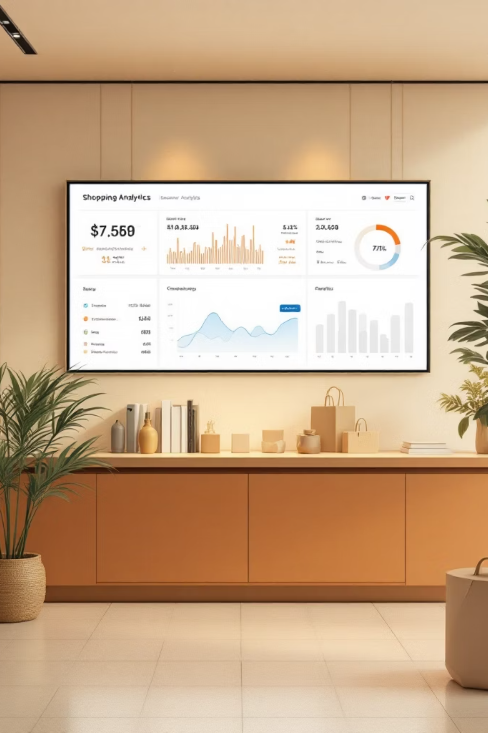
Customer Shopping Behavior Analysis
3,900 transactions analyzed • Predictive insights • Strategic recommendations

Slide 2

Business Objective
Strategic Goals
Identify revenue drivers and growth opportunities
Segment high-value customer profiles
Uncover behavioral patterns
Optimize marketing, pricing, and retention strategies

Slide 3
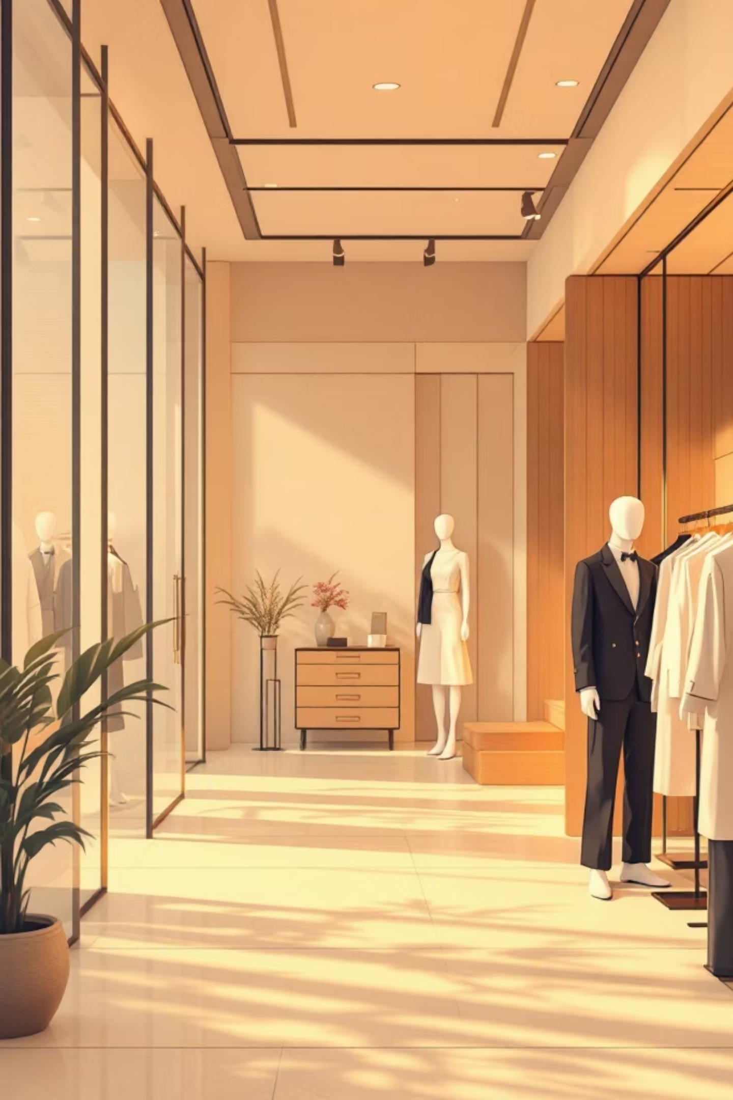
Category Revenue Performance
1st
45%
2.3x
Top Category
Revenue Share
Performance Gap
Clothing leads all product lines
Apparel drives nearly half of total sales
Outperforms next highest category significantly
Clothing dominates revenue generation with strong, consistent demand. Future growth depends on expanding apparel marketing and inventory investment.

Slide 4


Customer Demographics
Age Segment Analysis
Young adults generate the largest revenue share, representing the most valuable customer segment.
Primary Segment
Revenue Share
Strategic Value
Ages 18-35 drive highest transaction volume
38% of total sales from this demographic
Most responsive to targeted campaigns

Slide 5

Spending Behavior Patterns
Express Shipping
Standard Shipping
15% higher average order value
Baseline spending patterns
Free Shipping
12% increase in conversion rate
Customers choosing express shipping spend slightly more, indicating convenience-focused buyers represent higher-value customers willing to pay premiums.

Slide 6


Customer Loyalty Impact
Retention Drives Growth
62%
2.8x
Repeat purchases
Higher LTV
Most purchases come from loyal customers, meaning retention is the primary driver of sustainable revenue growth. Repeat buyers contribute significantly more over time.

Slide 7
Predictive Implications
01
02
Retention Focus
Clothing Priority
Revenue growth depends on keeping loyal customers engaged
Apparel will remain the strongest sales driver across all channels
03
04
Youth Market
Margin Watch
Young adults will continue to be the highest-value segment
Heavy discount reliance may reduce profit margins over time

Slide 8





Strategic Recommendations
Loyalty Programs
Invest in retention initiatives and rewards systems
Target Youth
Focus marketing campaigns on 18-35 demographic
Expand Apparel
Prioritize clothing inventory and promotional offers
Optimize Discounts
Balance promotions with margin protection strategies

